Slide 1


Seva Sindhu
“One platform, many services”

Slide 2










Seva Sindhu – Salient Features
Single window agency delivering government services in a cashless, paperless, faceless manner
850 services from 80 departments available
Till now 2.83 crore+ services have been delivered through Seva Sindhu from Mar 2018 till date
Covers entire spectrum of citizen services from application to delivery of service
Aadhaar based authentication: e-KYC - OTP and Biometric, Aadhar as financial address
Integration with SAKALA to ensure timely service delivery. Provides online option of Appeal in case of delayed service delivery
e-Sign for authentication by citizen & officials
Real time SMS and Email notification on application status changes
Integration with DigiLocker for storing output certificates
100% Digital payments - application fees as well as financial assistance
Detailed information disclosure of each service
Chatbot for 24/7 support for citizen queries
End-to-end development
Integrations with existing IT systems
Digitally signed QR code on output certificate for enhanced security
Automatic Geo-Location detection of user using KGIS data

Slide 3

Modes of Service On-boarding
Seva Sindhu runs on Service Plus Platform of NIC.
Services are onboarded in the following 2 methods
End-to-End
Integration
Applicable to Department services which are manually delivered as on today.
Application submission by the citizen & subsequent processing by Department officers are done on Seva Sindhu system
Database is maintained by Seva Sindhu
Advantages
Departments which have been unable to deliver services online can now use a completely online system
There is no financial burden to Department
Changes in the software are smoother due to complete ownership by the Government.
Applicable to services which are already delivered online by the Department.
Application submission by the citizens can be done on Seva Sindhu or on Department’s portal, while the processing happens on department’s application
Database is maintained by the respective departments
Web services are used for integration with the department application
Advantages
Presence of all services on a single platform helps the citizens more modes to avail department’s services.
Department can implement back-end changes in processes without affecting citizen facing application.
Citizens can now avail services through assisted mode and department need not invest on the same.

Slide 4
Features of Seva Sindhu
Integrated with ‘Mahiti Kanaja’ portal (https://mahitikanaja.karnataka.gov.in/) for proactive information dissemination.
Integrated with Sakala (Karnataka Guarantee of Services to Citizens (KGSC))
  Sakala Mission sets service delivery timeline
  Performance monitoring of disposals within prescribed time limit
Integration with DBT platform for payments using Aadhar as financial address
Comprehensive MIS with Dashboards for the decision makers
SMS and Email notification to the applicant on real time basis regarding application status changes (Submission, Clarification, Make Payment, Approved/Rejected, etc)
Feedback mechanism on the services availed by citizens in the portal, that are analysed for improving the system
Seva Sindhu has integrated ChatBot for 24/7 support for citizen queries

Slide 5
Features of Seva Sindhu
Versatile & agile platform, thus enabling onboarding of emergency services during crisis. For Ex: Disbursal of COVID related Financial packages (Construction labour, Street Vendors etc.)
Integration with other Government data sources (FRUITS, SATS, SSLC, PUC, AJSK etc.)
  Auto population of most of the form fields, thus, reducing number of document uploads and data entry.
  Efficient processing by departments
W3C, GIGW, NeSDA Compliant
Integrated with Kutumba - an Entitlement Management and Integrated Social Information System which consists of a social registry, integrated beneficiary management systems, beneficiary registry. 5.5 crore citizens enrolled.
Integrated with centralized grievance redressal system.

Slide 6

Health Centric Services
Senior Citizen Welfare Services
Bird’s eye view of sectoral coverage
Ayushmann Bharat- Arogya Karnataka ID Cards
Issue of certificates like age, male and female sterilization
Birth and Death Registration
Birth and Death Certificate
Youth Centric Services
Issue of Senior Citizen Card
Registration of NGOS which work for senior citizen welfare
Indira Gandhi old age pension
Labour Centric Services
Senior
Citizen
850
Live Services
Health
Labour
Youth
Application for admission, diploma certificate, migration certificate
Internship application , sports Scholarship, lifetime achievement spots award Kranti Kreeda Ratna
Stadium booking
Assistances to labourers for education, funeral, accident, marriage etc.
Pension schemes
Issue of duplicate identity card
Taayii Magu sahaya hastha
Farmer Centric Services
Women
Farmers
Women Centric Services
Industry Centric Services
Industry
Endosulphan Victim Pension
Farmer Widow Pension
Distress fishermen relief
Certificate of Registration as Seed/Plant Grower of Horticulture crops
Issue of Subsidy to Sericulturists for Drip Irrigation
Mathrushree Yojane
Manaswini Yojane
Widow Pension
Acid Victim Pension
Widow Bus Pass
Registration of IT/BT companies and Parks
NoC in favour of KPTCL/ESCOMs
Grant of license to manufacture insecticides, fertilizers and NPK

Slide 7
Seva Sindhu service Onboarding and Transactions Trend - Quarter wise
Services : 850 Departments: 80
No of Applications Received till 30 Nov 2022: 2.83+ Crores

Slide 8
Advantages of Seva Sindhu during COVID-19 Pandemic
Seva Sindhu was able to develop the application within 48 hours for COVID-19 related financial assistance schemes which were announced by Hon’ble Chief Minister of Karnataka. Some of the services developed are as follows:
Sl No | Category | No of Applications Received | Total Amount Transferred to Beneficiary (Rs Lakhs)
1 | Auto & Taxi Drivers | 4,91,733 | 17,338.64
2 | Street Vendors | 1,91,684 | 2,294.38
3 | Nekkar Samman | 1,07,934 | 3,510.13
4 | Powerloom | 1,53,810 | 4,609.42
5 | Television Artists | 5,148 | 78.81
6 | Lidkar (Chamara's) | 21,712 | 252.00
7 | Construction Workers, | 22,07,282 | 58,694.19
8 | Unorganised Labourers | 15,88,268 | 29,612.55
9 | Kannada & Culture | 26,209 | 585.69
10 | E-Pass for Inter State and Inter District travelers | 40,002
Total |  | 48,33,782 | 1,16,975.81

Slide 9
Seva Sindhu - Success Stories
During COVID Pandemic, Seva Sindhu was able to develop the application within 48 hours for COVID-19 related financial assistance schemes which were announced by Hon’ble Chief Minister of Karnataka. 4833782 beneficiaries have received Rs1200 Crore through DBT portal
Seva Sindhu was able to develop application for Transport department for providing scholarship to the children's of Auto and taxi drivers (Yellow board) with in 1week
Hon’ble Chief Minister of Karnataka had announced free bus pass to construction labourers and Seva Sindhu was able to develop the service within 48 hours
98 schemes from three departments under Suvidha project were developed and onboarded in Seva Sindhu within 1 week, when Suvidha platform suffered technical glitches

Slide 10
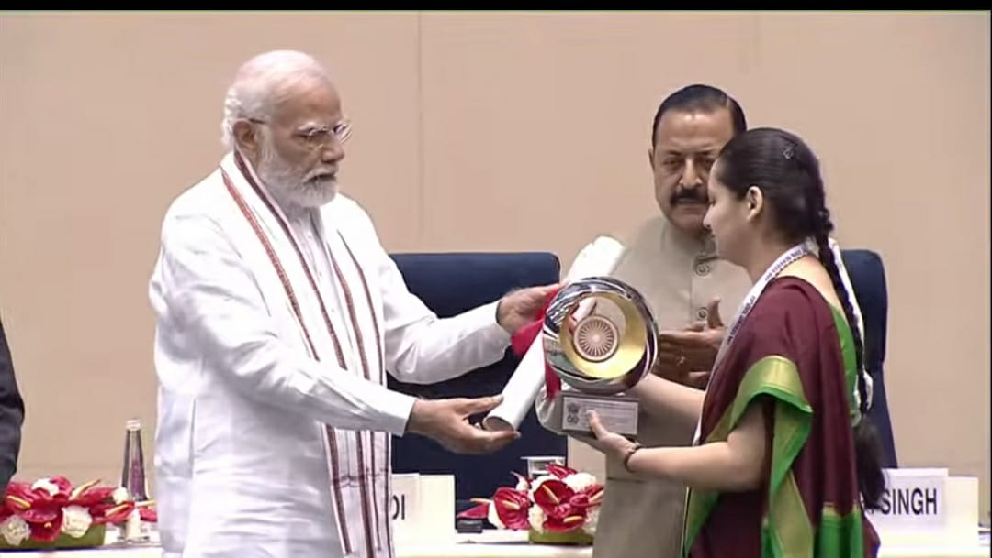
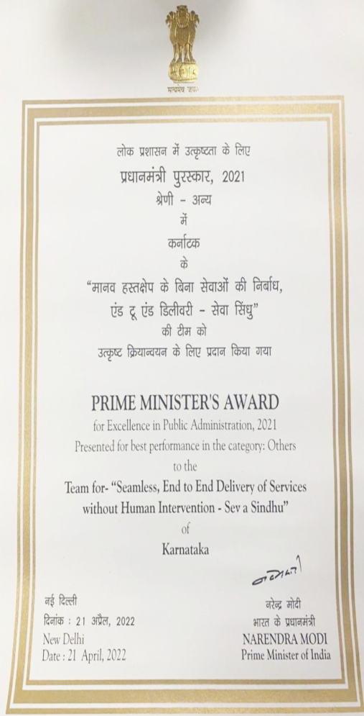
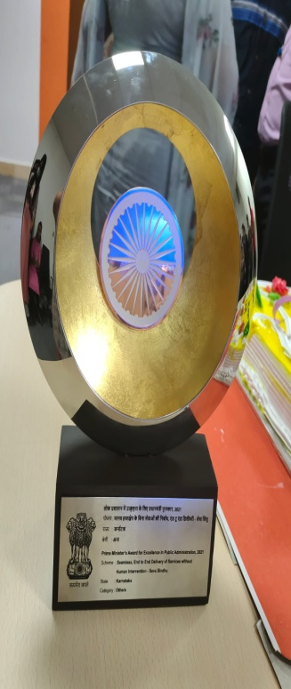
Awards and Recognitions
Seva Sindhu has won prestigious Prime Minister Award for Seamless End to End Delivery of Citizen Services without Human Intervention During the Year 2021-22

Slide 11
Modes of Service Delivery
  Online/ Self Mode
  Grama One
  Janasevaka (Door Delivery)
  Bangalore One and Karnataka One
Services are available online at https://sevasindhu.karnataka.gov.in/Sevasindhu/English
Single point assistance centre for all citizen centric activities at village level which includes delivery of G2C services, Banking services, Skill Upgradation etc.
5000 Centers (being extended to 9000 centers by March 2022)
Involves receiving of applications and delivery of services at the door-step of citizens in 198 wards of BBMP
79 services from 9 departments
Integrated citizen services delivery centers in Bangalore (146) & other cities of Karnataka (62)
Being extended to all Urban Local Bodies in the State by March, 2022

Slide 12
Grama One
Single point assistance centre for all citizen centric activities at village level which includes delivery of G2C services, Banking services, Skill Upgradation etc.
PPP Model wherein the Government is providing branding and technology. There is no financial cost to Government.
Operational Partner is responsible for setting of these centers at village level through franchisee mode.
Grama One Timeline:
Pilot Launch Date: November 19, 2020
District: Davangere, Chikkamagaluru, Vijayapura & Bidar
Number of Centres in Pilot: 300+ Centres
Project Launch Date: January 26, 2022
No of Districts: 31 Districts
Number of Centres: 8000+ Centres
No. of Services: 850 services
No of Applications: 14289058+
Envisaged Benefits of Grama One:
Saving on Opportunity Cost: No need to travel to district or taluk to avail government services. This will help in saving time & money of the citizens.
Employment: Employment opportunities for the local youth
SMART Governance: Accountability and Transparency in the service delivery to the rural citizens. This also means no dependency on middlemen to avail government services
Convenience: Grama One centers are operational from 8AM-8PM on all days, even on government
Financial Inclusion: By providing micro-banking services through Grama One centers, government will also achieve the mandate of financial inclusion

Slide 13

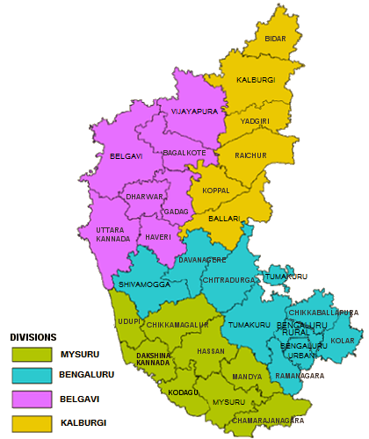
Overview of the State
Attributes | Information
No. of Districts | 31
No. of Divisions | 4
Total No. of GPs | 6022
Total No. of Villages | 27,431
Total Population | 6,19,98,012
*Source: 2011 Census Data
Division wise number of Grama One Centers:
Revenue Division | Number of Grama One Centres
Bengaluru | 2361
Belagavi | 2356
Kalaburgi | 1879
Mysuru | 2195
Total | 8791

Slide 14

Success Stories of Grama One
Before the introduction of Gramaone following services were mainly available to Urban population, GramaOne has helped in achieving Demographic and Social Inclusion by reaching to the citizen of Rural Karnataka
Pradhan Mantri Jan Arogya Yojana (PMJAY) Ayushman Bharat, a flagship scheme of Government of India, was launched as recommended by the National Health Policy 2017, to achieve the vision of Universal Health Coverage (UHC). This initiative has been designed to meet Sustainable Development Goals (SDGs) and its underlining commitment, which is to "leave no one behind.“ GramaOne has been instrumental in enrolling beneficiaries in the state of Karnataka and has enrolled more than 1 Crore beneficiaries.
Pradhan Mantri Fasal Bima Yojana (PMFBY) was launched from Kharif 2016 with aim to support production in agriculture by providing an affordable crop insurance product to ensure comprehensive risk cover for crops of farmers against all non-preventable natural risks from pre-sowing to post-harvest stage. The Scheme has completed 8 crop seasons and is being implemented across States/Union Territories (UTs). This service has catered to 5 Lakh farmers and collected total premium of 55 Crores.
Aadhaar Enabled Payment Service (AEPS) as a part of financial inclusions AEPS services are enabled in GramaOne centers wherein citizen can perform their financial transactions such as deposits, withdrawal, DMT (Domestic money transfer) using Aadhaar.

Slide 15
Success Stories of Grama One
Labour Bus Pass Service Hon’ble Chief Minister of Karnataka had announced free bus pass to construction labourers and GramaOne has helped more than 90% of Labors to avail this service in rural Karnataka.
PAN Card this is one of the most sort after service in rural Karnataka and more than 95% of applications has been received through GramaOne.
Pension Schemes GramaOne centers receive application for various pension schemes provided Directorate of Social Securities and Pension (DSSP) such as Farmer Widow Pension, Indira Gandhi National Old Age Pension, Manaswini, Physically Handicapped Pension, Sandhya Suraksha Yojane, Widow Pension etc. The pension amount is directly transferred to the beneficiary through Aadhaar based Direct Benefit Transafer (DBT)

Slide 16

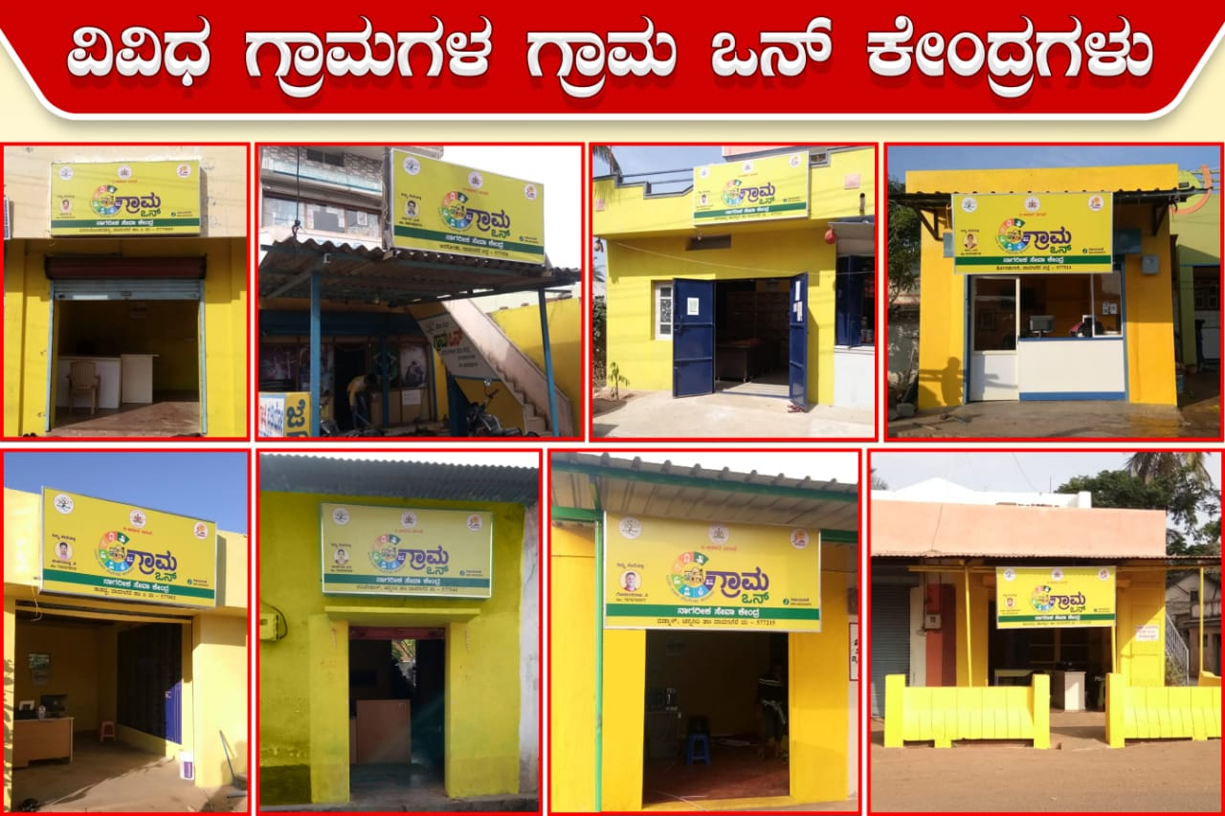
GramaOne centers

Slide 17
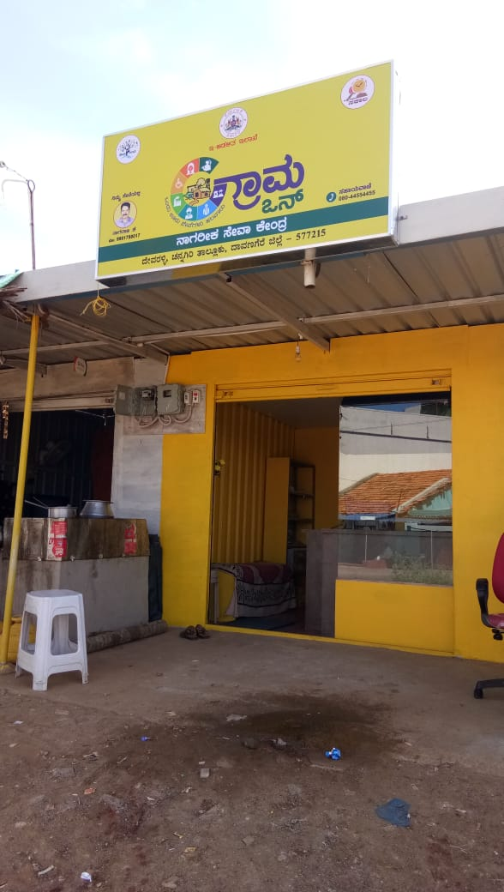
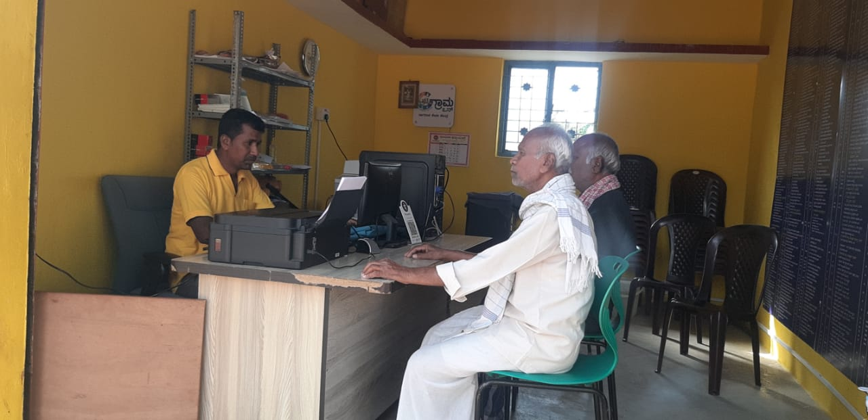
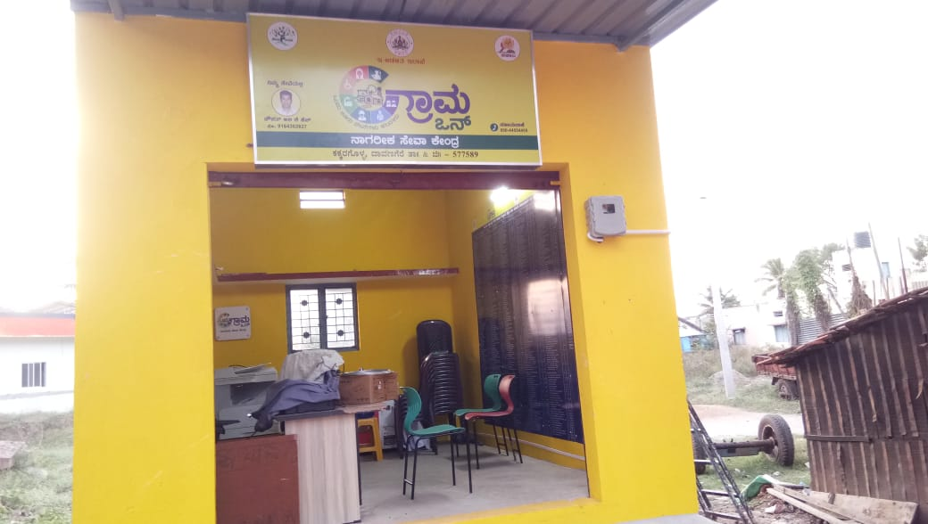
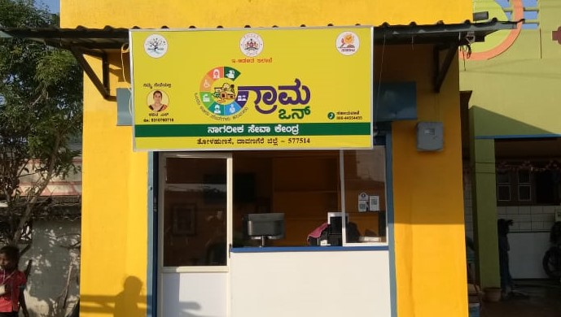
Grama One Centers
Ayushman Bharat Health Card Camp

Slide 18
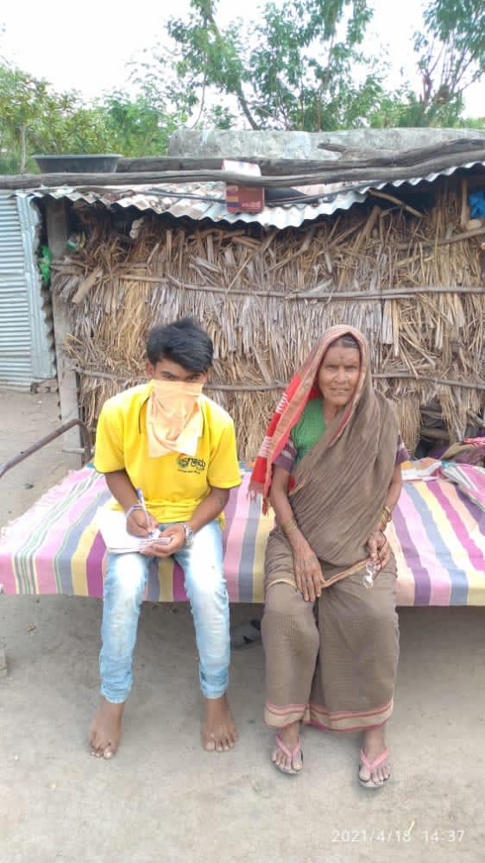
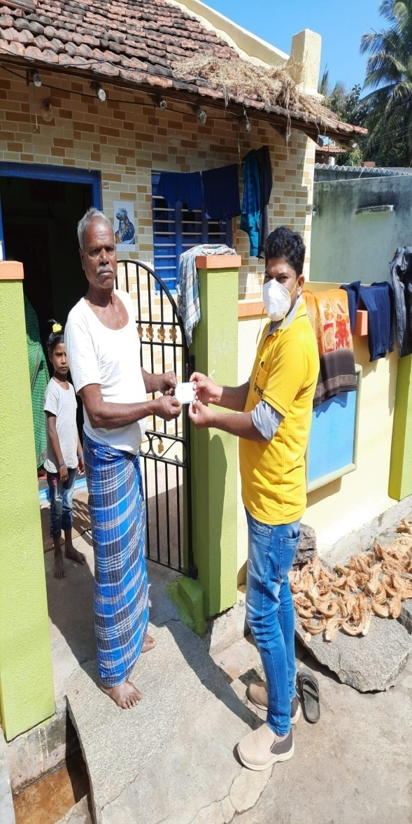
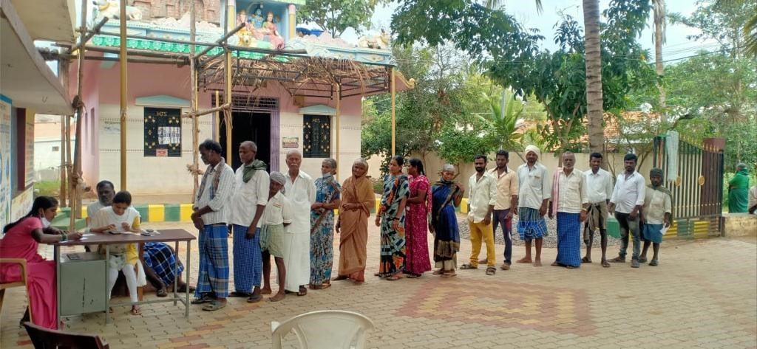
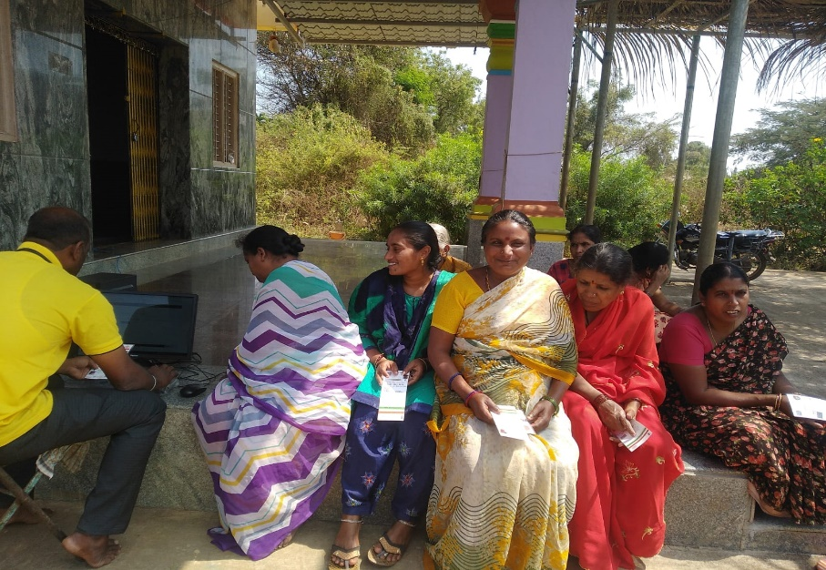
Door to Door Survey done by Grama One Operators

Slide 19
Special Drive for ABHA enrollment

Slide 20
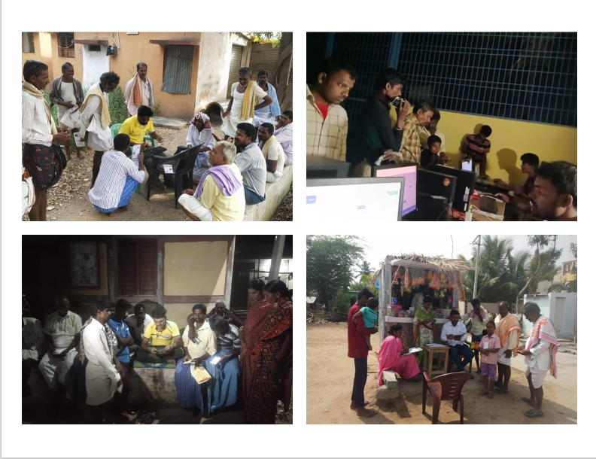

Slide 21
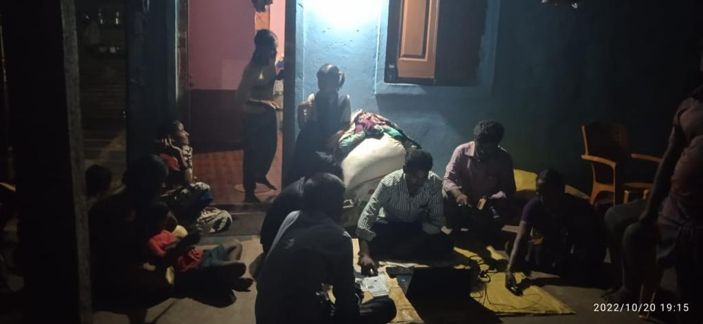
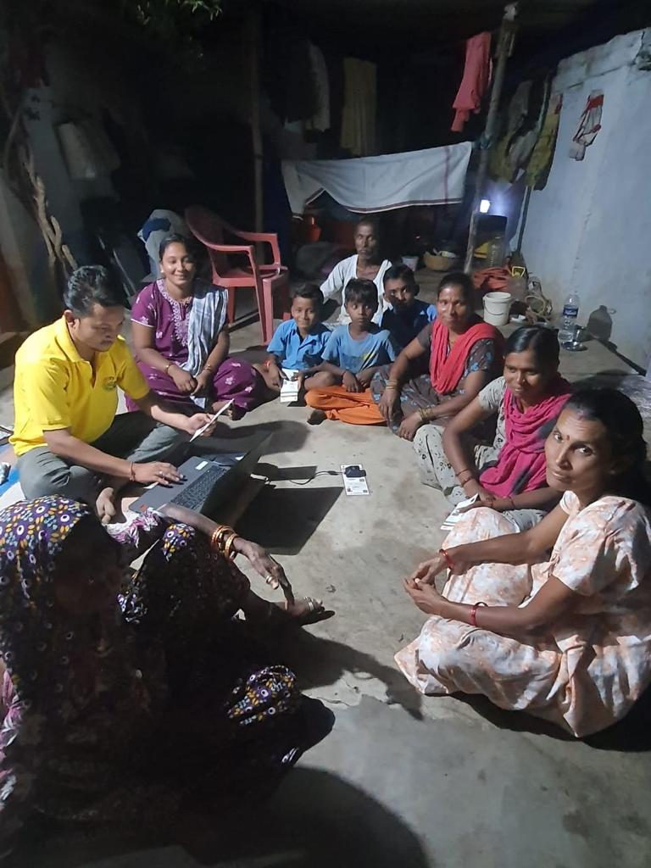
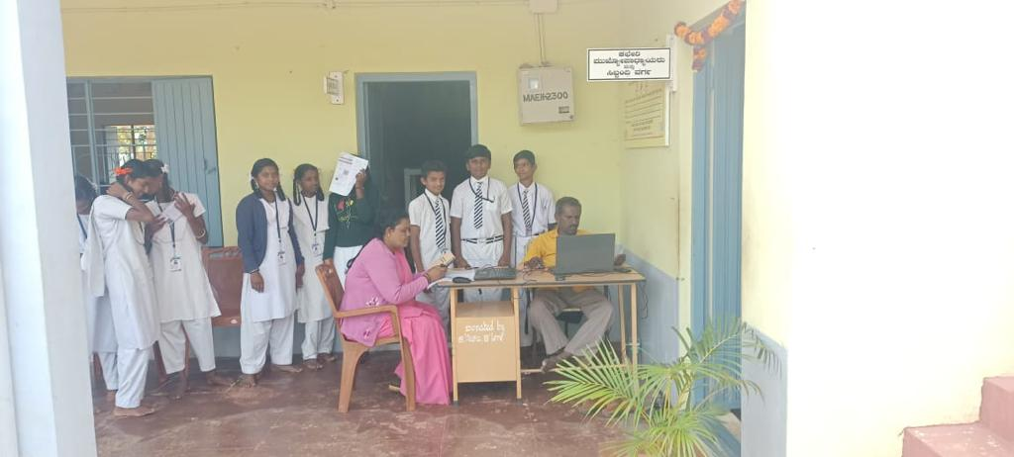
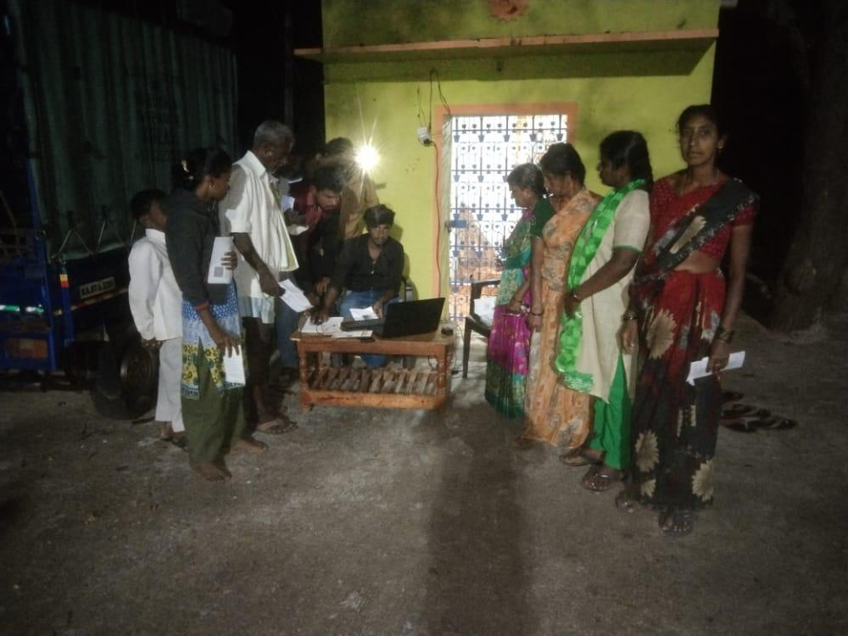

Slide 22

G
Grama one Video

Slide 23
Janasevaka
Janasevaka – This is a path-breaking citizen centric initiative introduced by the Government of Karnataka involving both receiving of applications and delivery of services at the door-step of citizens. This major reform changes the way citizen service delivery systems work.
Janasevaka Timeline:
Pilot Launch Date: March 2, 2019
Constituency: T. Dasarahalli
Pilot Expansion Date: February 4, 2020
Constituencies Added: Rajajinagar, Bommanahalli and Mahadevapura
Next Pilot Expansion: January 18, 2021
Constituency Added: Yeshwanthpur
No. of Services: 79 services
Expansion in Bengaluru Urban: November 1, 2021
No of Applications: 270000+
Benefits:
Time saving as citizens do not need to wait in queue to avail services
Cost saving as citizens do not need to travel to government offices or citizen service centers to avail these services
No more dependency on middlemen
Janasevaka visit can be booked anytime between 8AM to 8PM at the convenience of the citizens
Convenience to senior citizens and physically challenged citizens

Slide 24
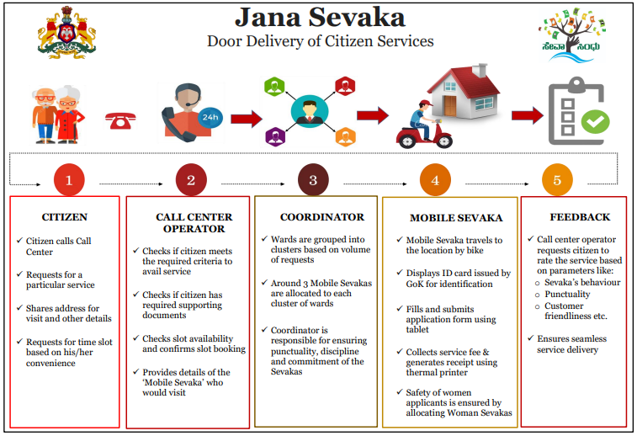

Slide 25
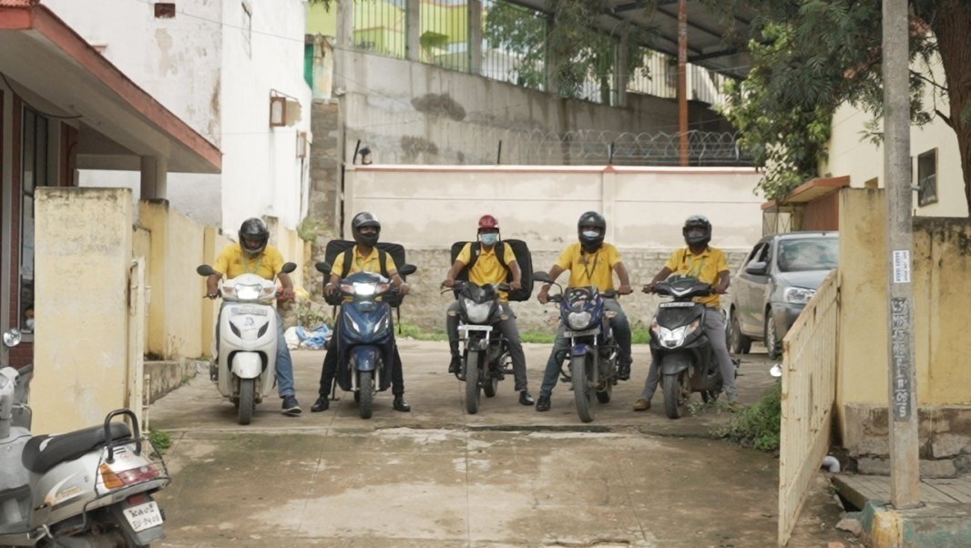
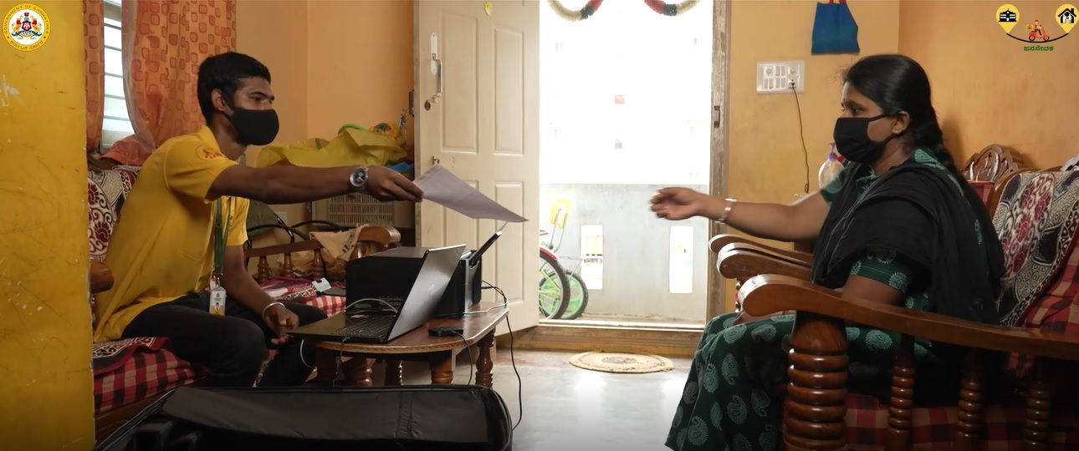
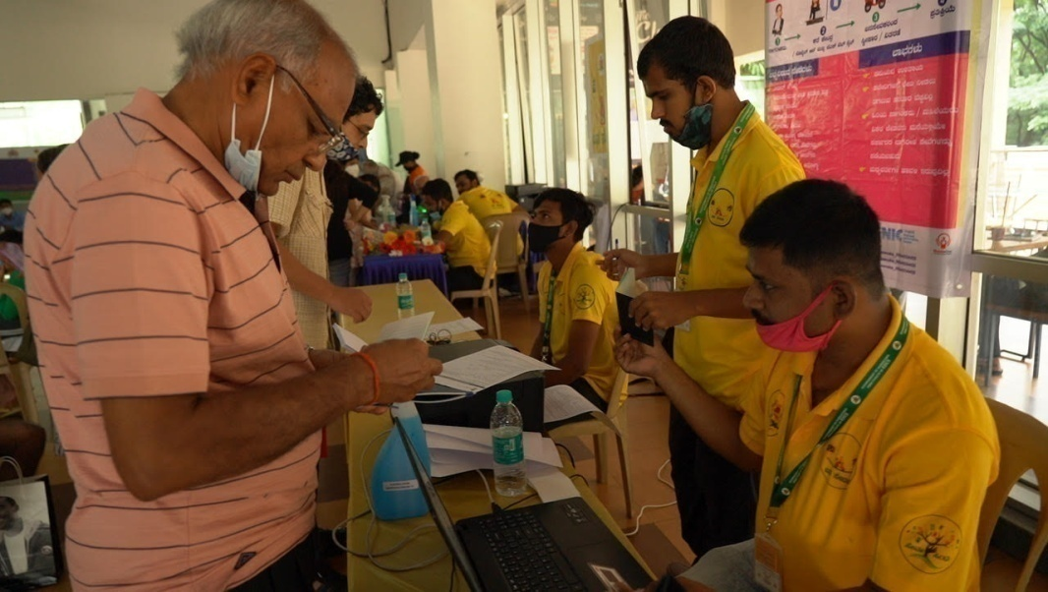

Slide 26
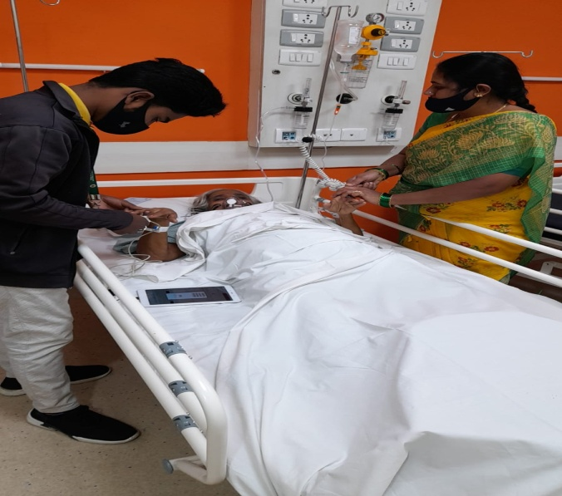
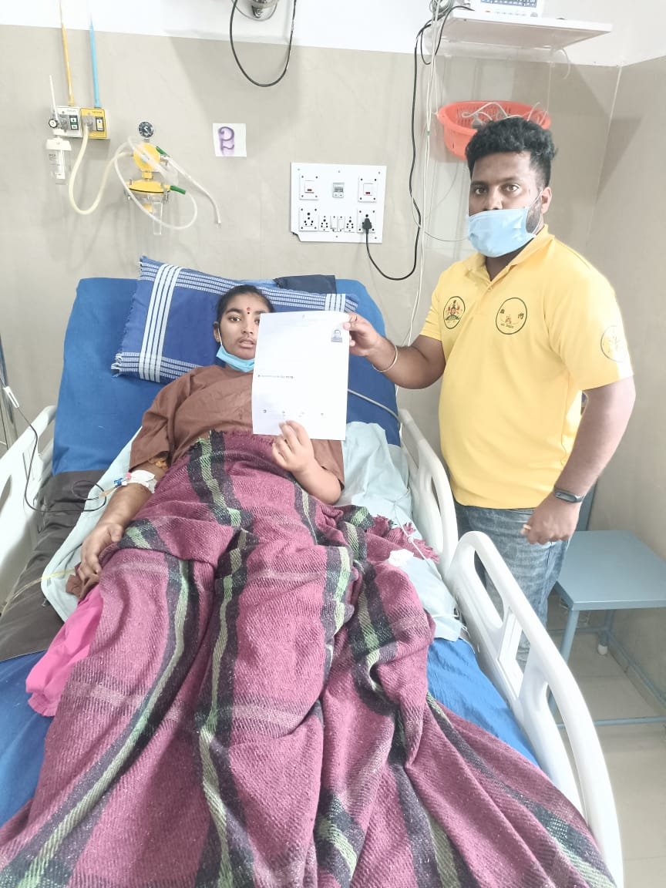
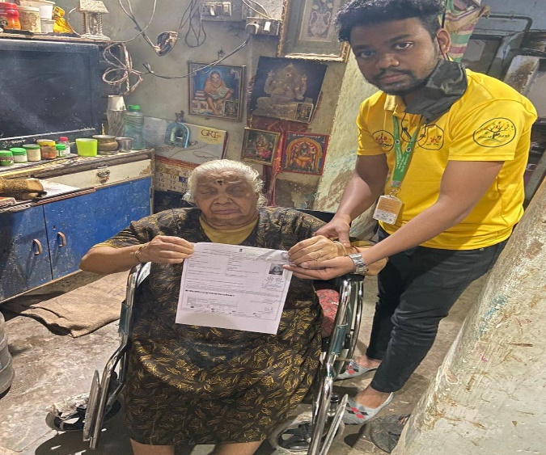
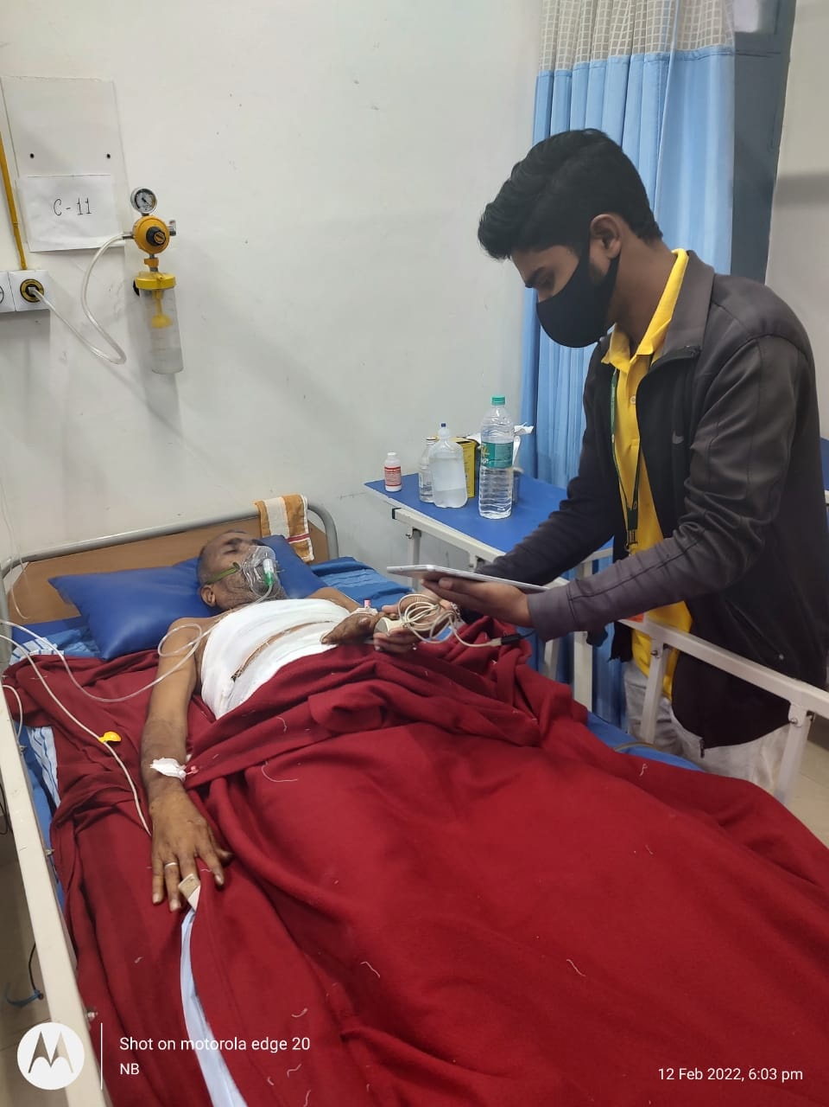
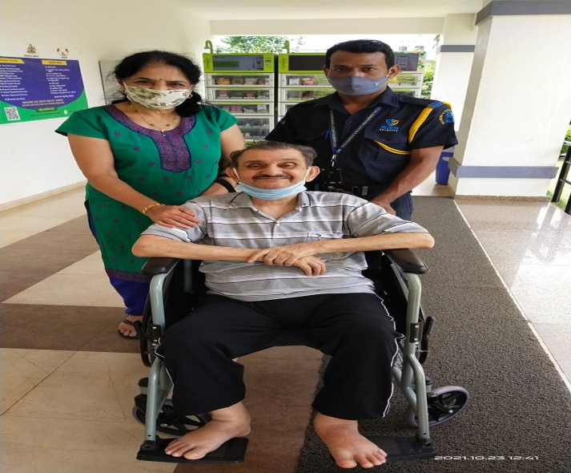
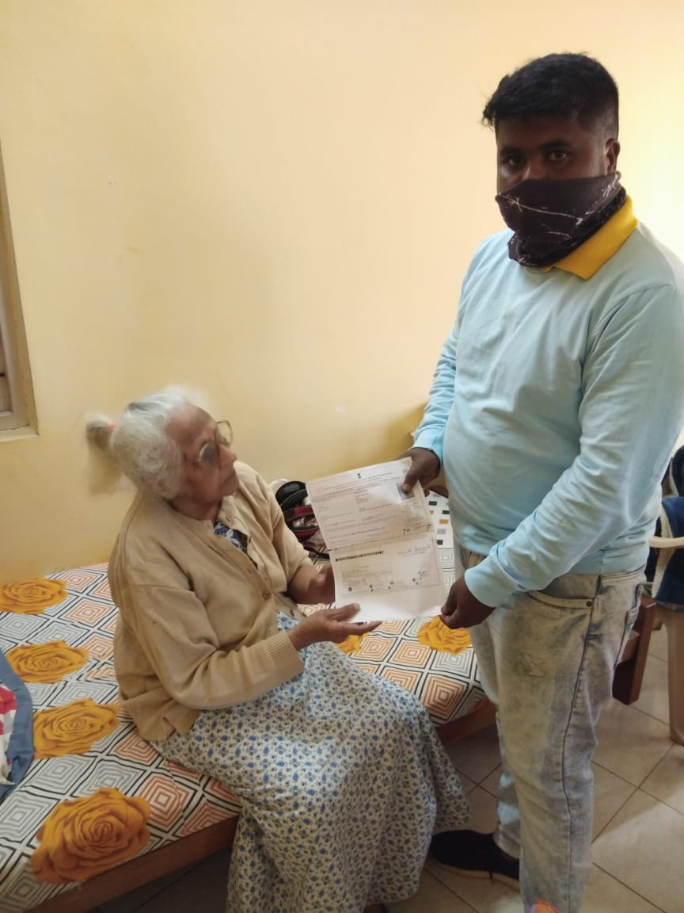

Slide 27
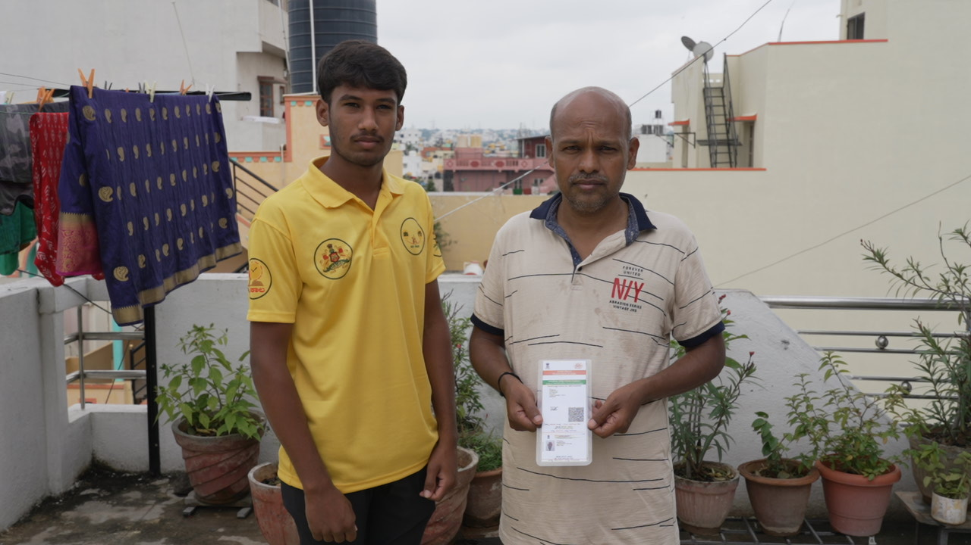
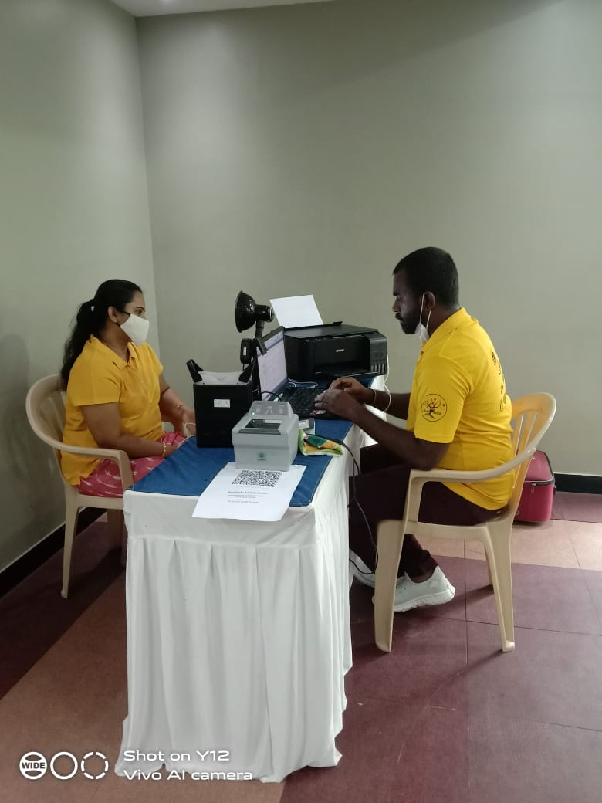
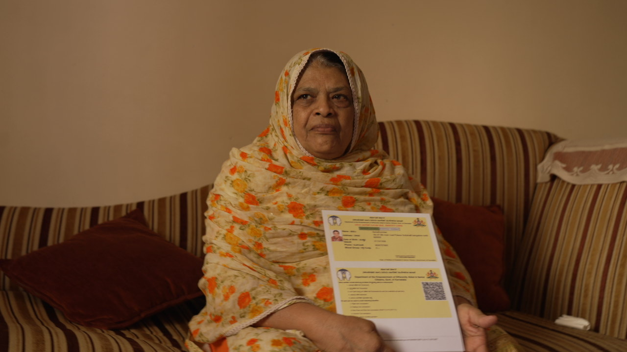

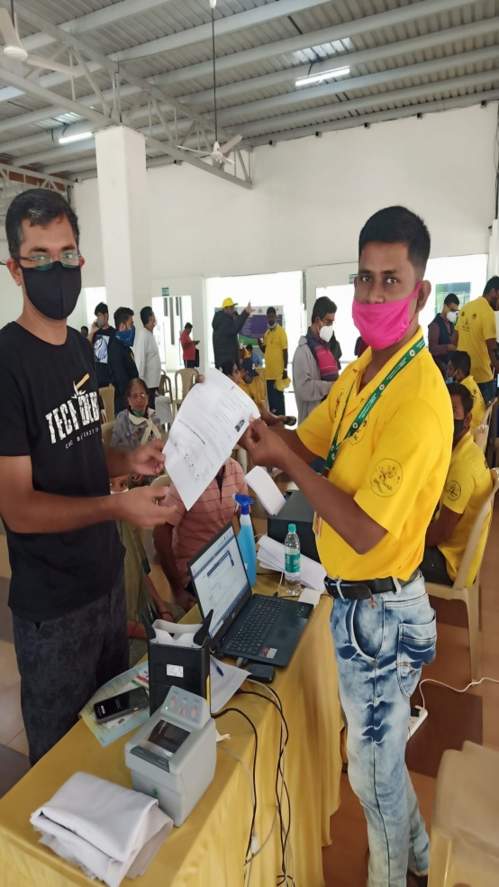
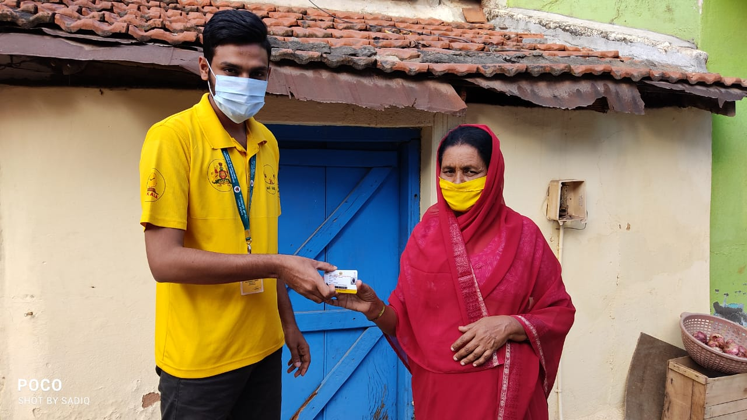

Slide 28
JanaSevaka Video

Slide 29
Best Practices
  Stakeholder consultation & Planning:
  Stakeholders are actively involved in the overall service development life cycle providing valuable inputs improving service design and outcomes
  Easy Access to Services:
  Provides a “screen reader” option in the portal for aiding visually impaired users
  Government Process Re-engineering:
  Involvement of departments have resulted in minimized process complexity, cost, service delivery time
  Paperless, Cashless, Faceless solution:
  As per the mandate given under ‘Digital India’ programme, Seva Sindhu promotes Digital payments for a cashless system

Slide 30
Best Practices
  Reducing Compliance Burden:
  Seva Sindhu offers end-to-end digital solution with features such as auto population of data fields, minimal scanning & uploading of supporting documents through integrations with multiple departments, thus enhancing user experience for G2C as well as G2B services. This also contributes to ‘Ease of Doing Business’.
  Reopening of applications in case of rejections without reasons:
  Seva Sindhu proactively checks 10% of the rejected application through an officer who can decide to reopen the application after scrutinizing the application form and annexure. Based on merit application can be considered for reprocessing.

Slide 31

Thank You

